Slide 1

Database Design Fundamentals for Developers
Will Tartak

Slide 2

About Me
President of VDS since 1990
Architect, Db Designer, Developer
25+ Years of Database Design
Over 40 Greenfield Databases in Production
Over 60 Databases Modified
More than 1,000 tables designed
Over 250,000,000 rows of data managed

Slide 3

What We Will Not Cover
Db Design History (E. F. Codd, Date, etc.)
1st, 2nd and 3rd Normal Form Definitions (Takes too long!)
Data Imports (Who needs data anyway?)
Performance (Don’t make all your fields nvarchar(max))
Indexing (You need them, go learn things…)
Query Optimization (Talk to Richie or some other expert)
Conceptual, Logical or Physical debate (just Logical, or is that Physical?)
Naming Conventions (follow them)
Object/Graph/Document/BI Databases

Slide 4

What We Will Cover
Going From “Flat” File to a relational db Design
Practical Approach
From “Flat” file to Relational Design
Basically:
Why do we do relational design
How do we do relational design

Slide 5

Agenda
A csv is a “Flat” file
Big Data can’t stay in a “Flat” file
Understanding Tables, Columns & Keys
Going to Relational
What Kind of Data?
What Repeats?
Where should it go?
Break them Loose!
Avoiding Pitfalls

Slide 6

A .csv is a “Flat” file
A Flat What?
There are many types of Flat files
Flat vs. Relational
Relational ~ Hierarchy
Not Exactly but easier to think of it this way
More like Relational supports Hierarchy
No Streamlining

Slide 7

Big Data can’t stay in a “Flat” file
Keep your data clean
If you want to avoid data duplication
Or you want Transactions
Or you want speed
Or more than 65,000 rows
Or…

Slide 8

Some Relational Fundamentals
Relational Databases are Primarily Composed of Tables
Plus Relationships
And Indexes
Tables have Columns
A Column has a Name, Type & a Size
Tables have Rows
Tables may have Keys
Keys are represented via Columns
Columns may have Indexes
Databases may have Relationships between Tables

Slide 9

The Keys are the Key
Primary Key
Foreign Key
Candidate Key
Surrogate Key

Slide 10
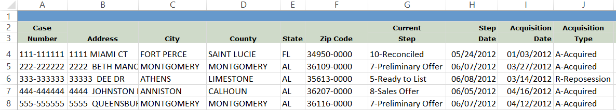
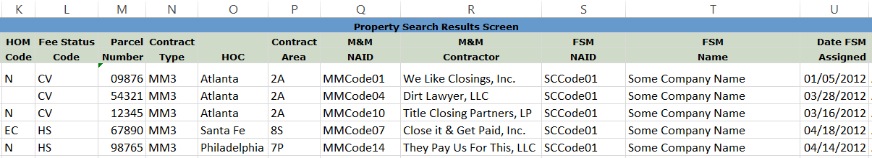
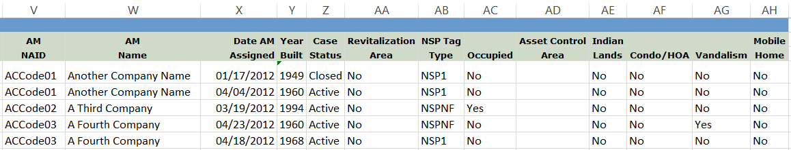
Going to Relational – Intro Summary (Flat)

Slide 11

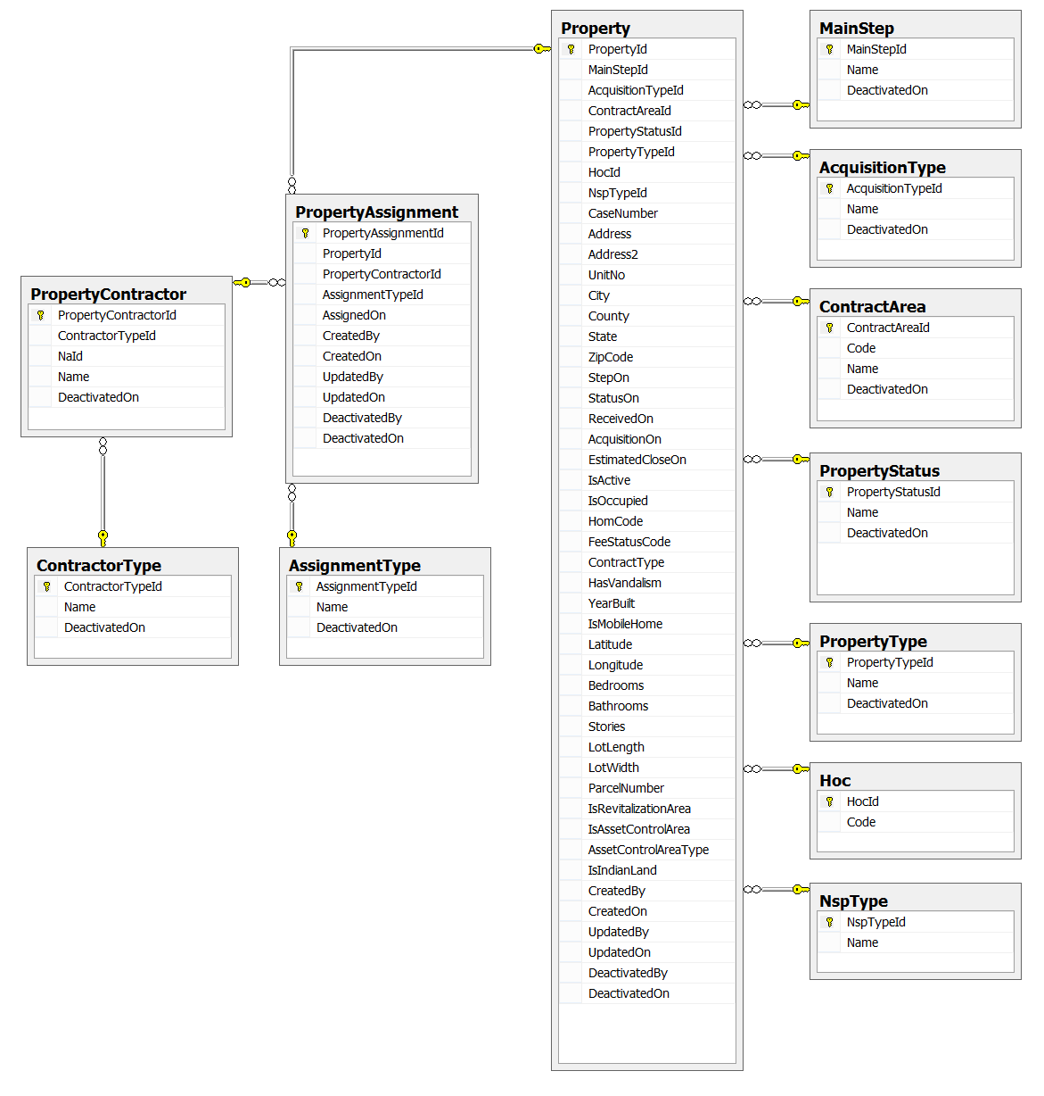
Going to Relational – Intro Summary (Tables)

Slide 12

Going to Relational – Kind of Data
Look for Unique values per Row
Look for Columns with names like:
Type
Code
Status
Step
Id
Look for Columns with duplicated values
Look for Columns with preset values
Yes/No
Closed/Active

Slide 13


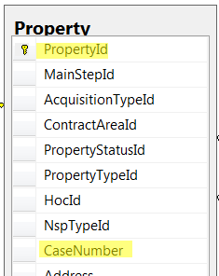
Keys are the Key

Slide 14

Going to Relational – What Repeats?
Do any values repeat within a column?
Should they be extracted?
Do any column names seem to repeat?
Do they hold similar or related data?

Slide 15

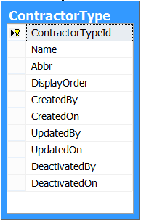
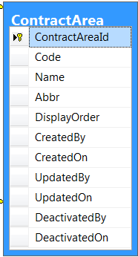
Going to Relational – Where should it go?
Repeating values may go into Lookup tables
What’s a Lookup table?

Slide 16

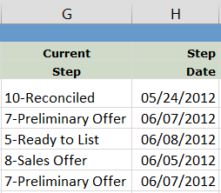
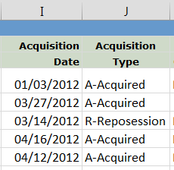
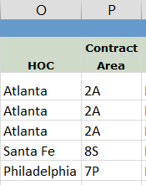

Going to Relational – Where should it go?

Slide 17

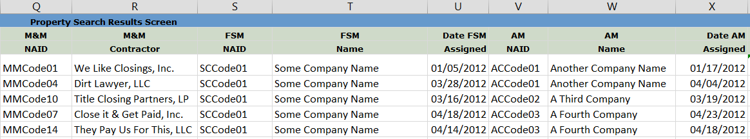
Going to Relational - Repeating Columns

Slide 18

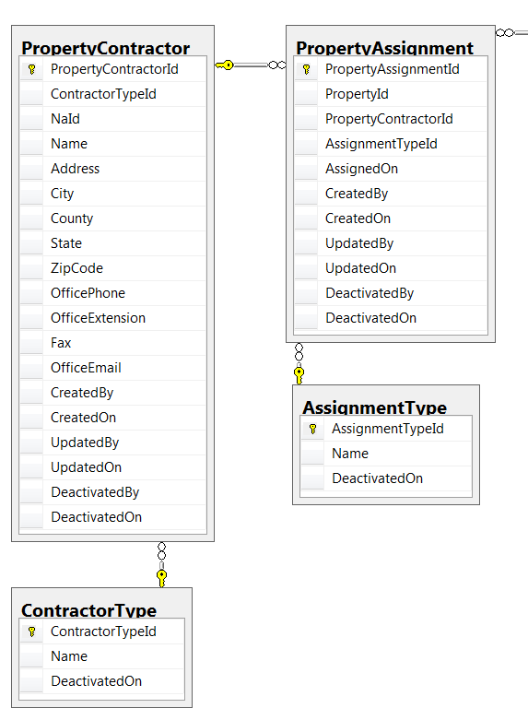
Going to Relational - Repeating Columns

Slide 19
Going to Relational – Source

Slide 20

Break them Loose!

Slide 21

Avoiding Pitfalls
What is a Number?
Size Matters
Matters of Precision
Match key types
The missing date field
Always have an Alternate
Foreign Keys & Indexes

Slide 22

In Conclusion
A csv is a “Flat” file
Big Data can’t stay in a “Flat” file
Understanding Tables, Columns & Keys
Going to Relational
What Kind of Data?
What Repeats?
Where should it go?
Break them Loose!
Avoiding Pitfalls

Slide 23

Questions?
Ask me, I dare you…
OR
Sorry, I’m out of time ☹

Slide 24
Thank You
Will Tartak
willt@VisualDataSolutions.com
Slides, db design and file available on github:
https://github.com/VDSFoundry/DbFundamentals
References
E. F. Codd – The Relational Model for Database Management
C. J. Date – The Database Relational Model: A Retrospective Review & Analysis
Joe Celko – SQL for Smarties
Fleming, von Halle – Handbook of Relational Database Design
Michael J. Hernandez – Database Design for Mere Mortals: A Hands-On Guide to Relational Database Design
Images Credit
http://www.space.com/28857-aurora-photos-northern-lights-2015.html

